Slide 1

Social Engagement using Video Technology for Care Partners of Persons with Dementia
Funding Agency: RRF Foundation for Aging (Grant #2021050)
Principal Investigators: Raksha A. Mudar, Minakshi Raj, & Wendy A. Rogers
Research Team: George Mois, Sarah Jones, & Ruchira Rao

Slide 2


Why is this project important?
16 million adults care for a family member with dementia
7.5 million care partners are over age 60
Support groups focus on caregiving activities
Our project provides engagement and enrichment for care partners outside of caregiving

Slide 3
Cost of Caregiving
Care partners over the age of 60 are most susceptible to negative outcomes.
Loneliness
Social Isolation
Cognitive Decline
Poor Physical Health

Slide 4
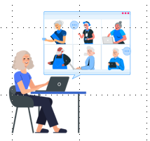

Aims of our Project
Aim 1: Understand facilitators and barriers to the adoption of a video-technology based social engagement intervention for Care Partners of persons with dementia.
Aim 2: Evaluate the overall benefits of a 6-week video technology-based social engagement intervention for Care Partners of persons with dementia.

Slide 5
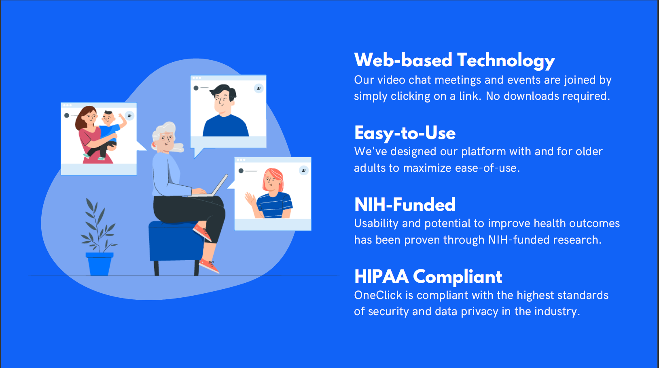
Video Technology Platform: OneClick.chat

Slide 6
Scope of our Intervention
Facilitate meaningful social engagement
  Topic centered conversation that promotes positive reminiscing (e.g., traditions, hobbies)
  Opportunities for respite from caregiving and caregiver issues

Slide 7


Food Around the World
Add Image related to content
Notes:
Title Slide
Change title and change the picture to match the title event name

Slide 8
Your Insights and Advice
Barriers and Challenges
Any barriers or challenges in implementing such technology-based interventions for care partners?
Advice and tips on how to overcome these barriers and challenges?
Our Intervention
What are some of the things that you think we should emphasize in our intervention?
How would you implement this intervention in your organization/programs?
What care partner needs (e.g., technology, internet) do you think need to be met to ensure successful participation in our intervention?
Recommendations for recruitment?
Barriers to recruitment that we should consider?

