Slide 1
Financial Scams
Heidi D. Ponder, Vice President
Director of Fraud/AML
Heidi.Ponder@busey.com
Chad Tennill, Fraud Manager
Chad.Tennill@busey.com

Slide 2
Who are the victims of scams?
EVERYONE!
There are some scams that target certain age groups, but for the most part the scammers don’t care who they are targeting. Their goal is to get someone to respond to their scam so they can get money.
Scams don’t just target individuals with good credit scores or a lot of disposable income.

Slide 3
Lottery Winnings Scams
This scam will tell the recipient they have won a lottery/sweepstakes or survey.
The amount of money the individual has “won” will be significant.
A check may be sent with the letter to help offset the processing fee, taxes, insurance or other such fees.
The letter will instruct the recipient to call a claims agent to assist them with the process.
The claims agent will instruct the receiver to deposit the check in order to help offset some of the expenses associated with winning.

Slide 4
Lottery Winning Scams
The recipient will be instructed to wire most of that money back to the agency to start the claims process.
The recipient deposits the check in their bank account and receives credit from their bank for the deposit.
The recipient sends a wire to the agency so their claims process can start.
The check is returned to the bank and charged back to the recipient’s account. The recipient has now lost the money.
TIP: If you didn’t enter a lottery/sweepstakes, you can’t win one!

Slide 5
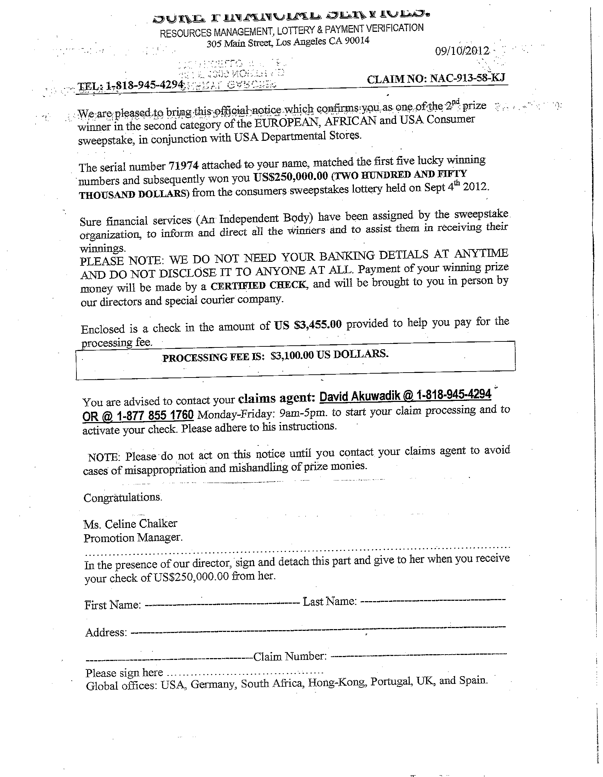

Slide 6
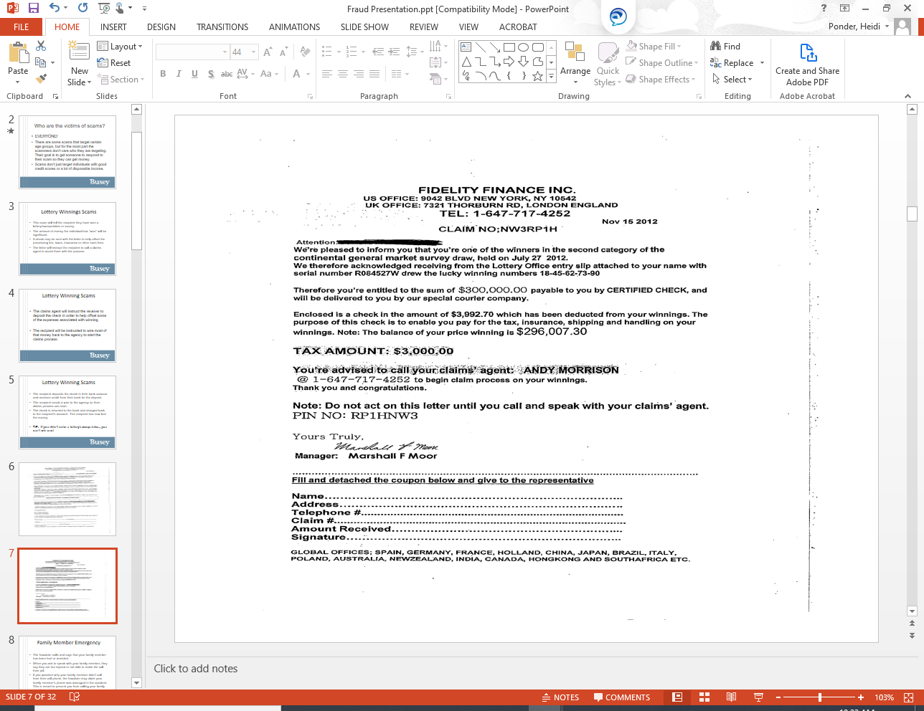

Slide 7
Online Romance Scams
Be extremely careful when meeting anyone online. The person you’re communicating with may not be who they claim to be.
The fraudster will typically communicate with the victim for several months to build a rapport and trust.
After several months the fraudster will ask the other party to send them money or process money through their account on the fraudsters behalf.

Slide 8
Online Romance Scams
They will give a reason for needing the victim to process money on their behalf. Reasons that we’ve heard that our customers have been provided is that the fraudster is in the hospital and can’t be released until their bill is paid and they don’t have anyway to process the funds they have for payment. They will then send a wire or check and ask you to send the funds on to another party. We’ve also heard that they will indicate they are in a country that does not allow them to process US funds.

Slide 9
Online Romance Scams
Do not be lulled into a sense of security just because you’ve been communicating with someone for several months. Their end goal is to get you to process funds for them that they have obtained illegally, or for you to send them money from your own account.
Always use caution when anyone is asking you to process a transaction on their behalf or for you to send them money that they promise to repay.

Slide 10
Family Member Emergency
The fraudster calls and says that your family member has been hurt or arrested.
When you ask to speak with your family member, they say they are too injured or not able to make the call from jail.
If you question why your family member didn’t call from their cell phone, the fraudster may claim your family member’s phone was damaged in the accident. This is meant to prevent you from calling your family member.
The fraudster will provide instructions to wiring funds or purchase prepaid cards and provide the account numbers and activation codes.

Slide 11
Family Member Emergency
Some customers have said individuals get on the phone claiming to be their family member. The person receiving the call is so distraught they believe it is their family member’s voice.
Typically the caller will tell you not to tell anyone about this call and you need to act quickly.
If you receive one of these calls, ask other members of your family if they have heard from the family member that is supposedly in trouble.
Don’t let the caller panic you.
The fraudster is hoping you will act on impulse without verifying the information you are being told.

Slide 12
Mystery Shopper Scam
A scammer sends a letter indicating you have been selected to “shop” at local businesses to test their customer service. The letter will also contain a check.
If you agree to participate you will be paid for your service.
The letter will instruct you to call a representative for further instructions.
The representative will instruct you to purchase a few small items at a store they designate.
They will instruct you to use the majority of the funds to transmit a Western Union, or other similar transmission, or to purchase a prepaid card and provide them the card number and activation code.

Slide 13
Mystery Shopper Scam
You will be given the name and address of where to send the funds. Typically the funds will be sent to another individual.
You will be instructed to deposit the check that was sent to perform the requested tasks.
A few days later, the check is returned and charged back to your account.
You are out the money for the entire check.

Slide 14
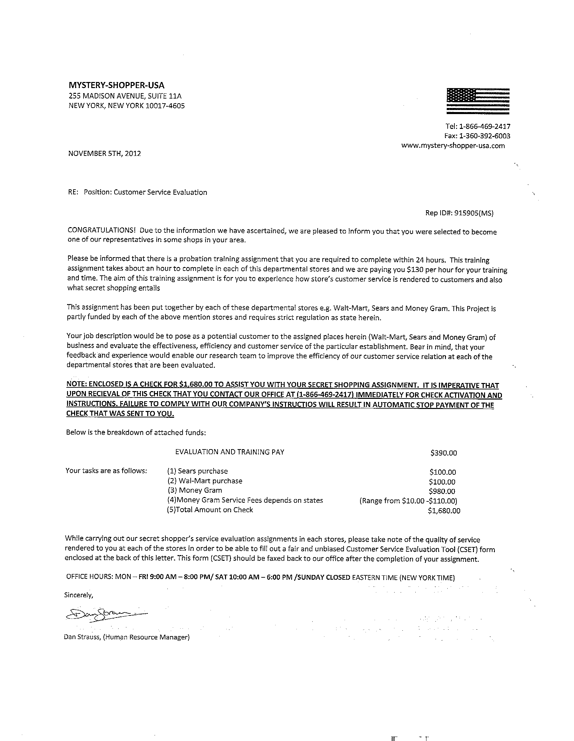

Slide 15
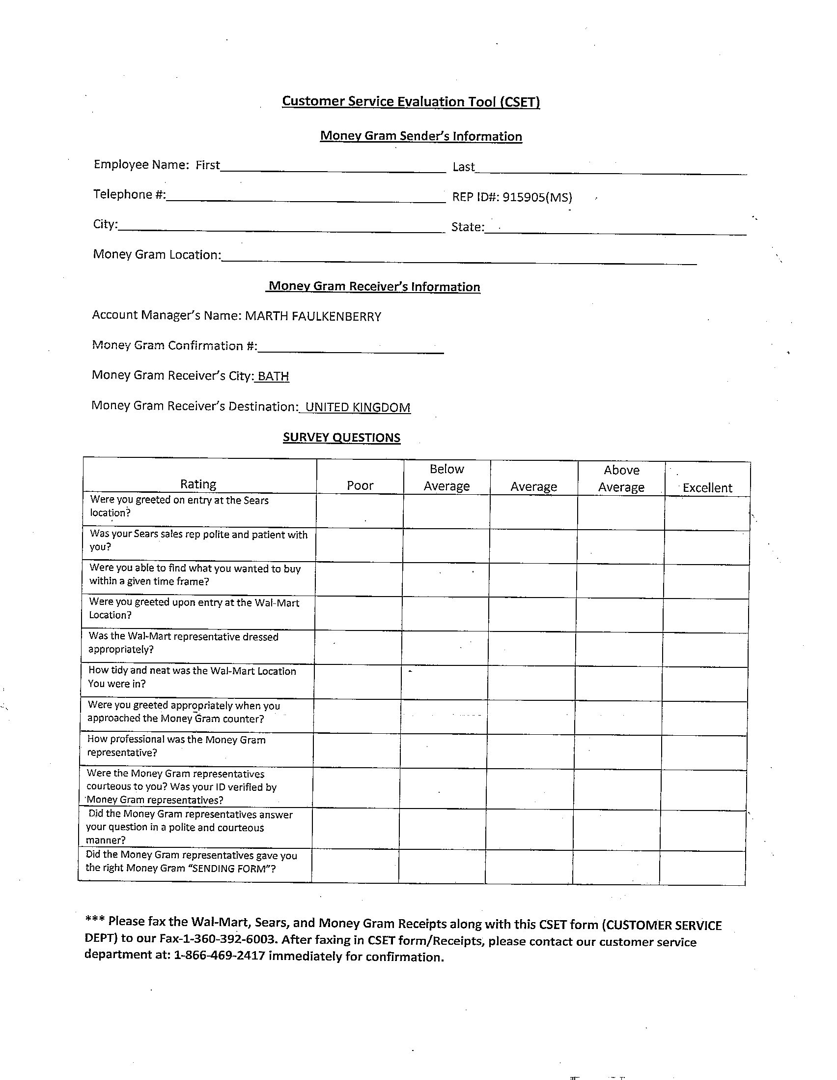

Slide 16
Bank Employee Theft Scam
The victim receives a call from someone claiming to be from the bank’s fraud department. They tell you the bank is working on a case involving a employee they believe is stealing money.
They explain they believe an employee is taking cash from customers and not reporting it to the proper place, or crediting the customer’s account.
They ask if you will help by withdrawing cash from the bank.

Slide 17
Bank Employee Theft Scam
The scammer meets you at a public place to receive the money. They tell you they will “mark” the bills and an uncover police officer will take it to the bank to do a transaction.
The scammer will provide a receipt to verify you provided cash to assist with the sting.
The scammer says they will call you in a few days to return the money.
The victim will never hear back because the person who called was not a bank employee.
No bank will ever ask a customer to assist with this type of event. Financial institutions have procedures to handle internal thefts, and they do not involve help from a customer.

Slide 18
Vishing Scams
A vishing scam involves a criminal trying to obtain bank information from a victim by falsely representing themselves as bank or credit card company.
The victim receives a phone call or text message indicating that their debit/credit card has been restricted for security purposes. They are told to resolve the matter they need to speak with a representative.
The “representative” will tell the customer that their card was restricted due to a suspicion of fraud.
They will ask for the debit/credit number, expiration date and the card validation value code (CVV) on the back of the card.

Slide 19

Vishing Scams
Financial institutions will never ask for your card information. Banks will know your card number and will not ask you to provide it. They may verify some part of your card number, but they will provide the numbers to you to verify back to them.

Slide 20
Vishing Scams
Banks and credit card companies do monitor for unusual or suspicious activity on debit/credit cards.
If transactions appear to be abnormal for the account, they will reach out to the customer.
However, they will provide information to you and ask you to verify the transaction.
FINANCIAL INSTITUTIONS WILL NOT ASK FOR CARD OR ACCOUNT INFORMATION.

Slide 21
Inheritance/Investment Scam
These have both been around for several years, and used to be referred to as the “Nigerian Scam,” as they often originated in Nigeria.
A victim receives an email indicating a relative you were unaware of has died and left you an inheritance.
They want to send you money in advance to help offset the expenses associated with the process.
Sound familiar? Just like the lottery/sweepstakes scam.

Slide 22
Inheritance/Investment Scam
In the investment scam, the scammers claim to be from another country where the country is experiencing financial distress. They request you help them move money from their country to the U.S.
They will send you a check, and after receiving it they will contact you indicating they have an emergency and need the funds returned to them.

Slide 23
“YES” Scam
The fraudster will call and ask a question to get you to answer “yes.” Questions such as “Can you hear me?” or “Are you the homeowner?”
They will then use this as affirmation to “prove” you authorized something, such as a payment on a bill or a charge on a credit card.
You can protect yourself by:
  Not answering calls from unfamiliar numbers.
  Review your bills and statements for unauthorized charges. If you find an unauthorized charge, contact the biller immediately.

Slide 24
Computer Repair Scam
You receive a call or a pop-up message indicating an error on your computer. The message will direct you to call for assistance.
The representative offers to remote into your computer to assist you. But before they do that, you will need to provide payment information.
They will also ask you to provide your online banking User Name and Password.
After “fixing” the issue they will process a charge for the services rendered.
Shortly after, they will contact you and inform you they have issued a refund for a number of reasons – from overcharging you to business closure.

Slide 25
Computer Repair Scam
They will indicate they issued the refund for too much, for example, they sent $4,000 instead of $400.
They will ask you to send the refund back to them so they can process the correct amount, or to send back the different in refund amounts.
Review your accounts carefully. The deposit in your account is actually a transfer from one of your own accounts. It is not a credit from the fraudster.
The scammer will likely have logged into your online banking and made a transfer from one of your other accounts. They can put a description in the transfer that makes it appear to be from the business.
If this scam happens to you, immediately change your online banking User Name and Password and let the bank know. They will be able to assist you with additional steps to help you protect your accounts as the scammer has seen your account number when they were in your online banking.

Slide 26
Other Scams
Tax return scams – Claims you owe taxes and must pay them immediately to avoid being arrested.
        Information can be found at www.irs.gov.
Jury duty scams – Claims you have missed jury duty and must pay a fine to avoid being arrested.
  Check with your local courthouse to see if you
  have missed jury duty.

Slide 27
How to Protect Yourself
Know who you are talking to. If you didn’t initiate the phone call and are uncomfortable with what they are asking – hang up, do research and find a phone number to call back. Don’t call back on the phone number they provide unless you can verify it is legitimate.
If the caller claims to be from your bank, call them back at the phone number on your bank’s website or business card.
Review your bank statements in a timely manner. You may have limited time to report unauthorized or fraudulent activity.

Slide 28
How to Protect Yourself
Store information in a safe place. Shred anything that has personal information on it. Do not write your PIN number on your debit/credit card.
Know when you should receive statements and call if you don’t get them.
Visit www.ftc.gov for valuable information on how to deal with various scams and Identity Theft.
Obtain and review a credit report annually to ensure the information is correct.
  Experian (888) 397-3742
  Equifax (800) 685-1111
  TransUnion (800) 888-4213

Slide 29
What to do if you are a victim?
  Notify your bank.
  File a police report.
  If you are a victim of Identity Theft call the Federal Trade Commission at (877) 438-4338.
  If you provided personal information, call the credit bureaus and have a “fraud alert” placed in your file. Also request a free credit report.
  Contact any creditors where fraudulent accounts may have been opened.

Slide 30
What can the bank do to help?
  Provide documentation for the police report.
  Place an alert on your account indicating you have been a victim, and establish other security measures for your account.
  Assist with closing a compromised account/card and opening a new one.
  Unfortunately, we can’t give you back money that you lost in a scam.

